Slide 1
Information System Design
ISD Models
Notes:
Lecture# 19
24/10/2007
IT60105: D. Samanta, SIT, IIT Kharagpur

Slide 2
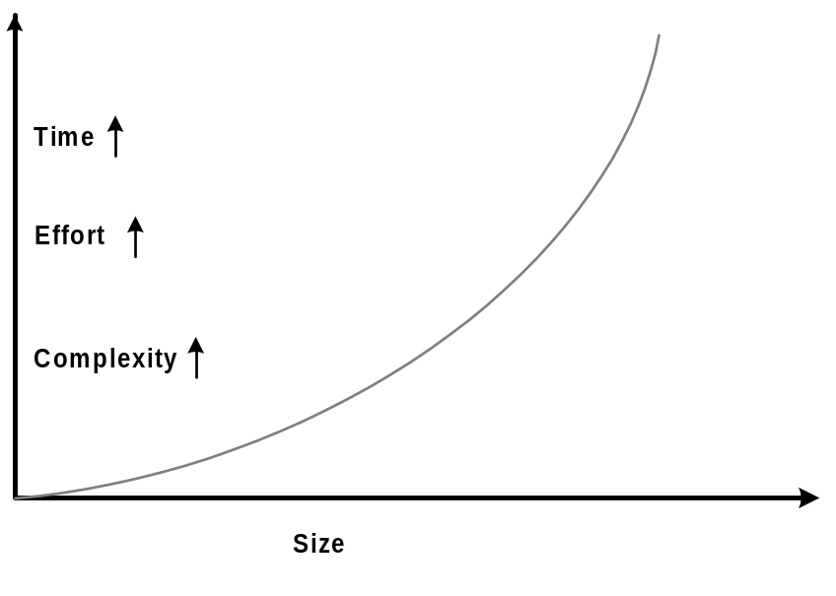
Why Planning Information System Design?
Program vs. Software
  Size (small/big)
  Effort (Individual/Team)
  Application and user
  Reliability (testing)
  Documentation (manual)
Technological growth
  Hardware
  Software
  Communication
IT based society
Information System Design
Notes:
Lecture# 19
24/10/2007
IT60105: D. Samanta, SIT, IIT Kharagpur

Slide 3
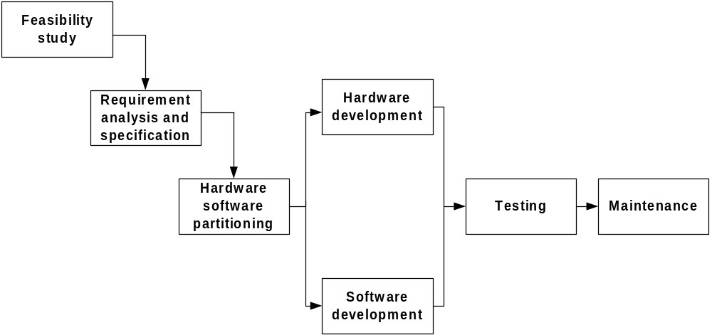
ISD Engineering
Information System Design
Notes:
Lecture# 19
24/10/2007
IT60105: D. Samanta, SIT, IIT Kharagpur

Slide 4
Development Models
Software Design Life Cycles
  Classical Waterfall Model
  Iterative Waterfall Model
  Prototyping Model
  Evolutionary Model
  Incremental Model
  Spiral Model
  Time-boxing model
  Rapid Application Development
  Component-based Software Engineering
  Agile process model
  RUP process model
Information System Design
Notes:
Lecture# 19
24/10/2007
IT60105: D. Samanta, SIT, IIT Kharagpur

Slide 5
System Design Life Cycle
A system design life cycle is a process consists of set of methodologies (activities) beginning from system inception through delivery and retirement
Basic activities in a system design life cycle are:
  Feasibility study
  Requirement analysis and specification
  Design
  Coding
  Testing
  Maintenance
An activity is also alternatively termed as a life cycle phase
Number of life cycle models are known to system designers
  All models are same so far the basic activities are concerned
  Models are different so far the order of activities are concerned
Information System Design
Notes:
Lecture# 19
24/10/2007
IT60105: D. Samanta, SIT, IIT Kharagpur

Slide 6
Why a Life Cycle Model?
It encourages development of system in systematic and disciplined manner
Provides better understanding and communication among team members
Pipelining the activities to be carried out in number of dissimilar projects together
Better utilization of resources (human + system)
Information System Design
Notes:
Lecture# 19
24/10/2007
IT60105: D. Samanta, SIT, IIT Kharagpur

Slide 7
Software Development Life Cycle
Product development process is carried out as a series of certain activities for software production. Each activity in the process is also referred to as a phase.
General activities include feasibility study, analysis, design, coding, testing, implementation, and maintenance.
Collectively, these activities are called the software development life cycle (SDLC) or phased development life cycle or software life cycle and each of these activities are called life cycle phase.
The SDLC provides a framework that encompasses the activities performed to develop and maintain software.
Some of these models are waterfall, prototyping, spiral, incremental, agile process, RUP process model, and so on.
Information System Design

Slide 8
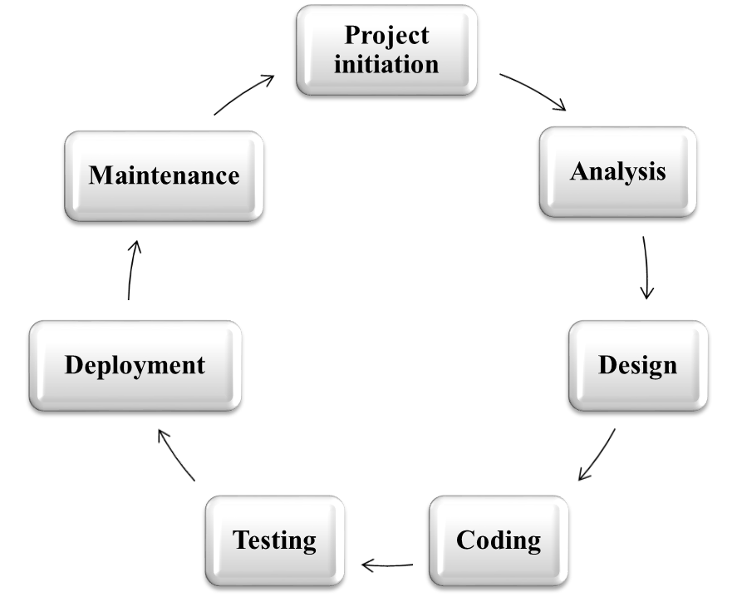
Phased Life Cycle Activities
SDLC
Figure 2.3: Software Development Life Cycle (SDLC) activities
Information System Design

Slide 9
Phased Life Cycle Activities
Project Initiation
  The aim of project initiation is to study the existing system; determine the feasibility of a new system; and define the scope, key elements, and a plan for the successful completion of the project.
  Project initiation involves preliminary investigation, feasibility study, and a project plan.
  Preliminary investigation (PI) is the initial step that gives a clear picture of what actually the physical system is.
  PI goes through problem identification, background of the physical system, and the system proposal for a candidate system.
Information System Design

Slide 10
Phased Life Cycle Activities
Project Initiation
  The purpose of the feasibility study is to determine whether the implementation of the proposed system will support the mission and objectives of the organization.
  Feasibility study ensures that the candidate system is able to satisfy the user needs; promotes operational, effective use of resources; and is cost effective.
  There are various types of feasibility study performed, such as technical, economical and behavioral.
  Feasibility report is prepared and submitted to the top-level management. A positive report leads to project initiation.
  A detailed project plan is actually prepared after knowing the requirements.
Information System Design

Slide 11
Phased Life Cycle Activities
Requirements Analysis
  Requirement analysis is the process of collecting factual data, understanding the processes involved, defining the problem, and providing a document for further software development.
  Requirement analysis or requirements engineering is a systematic approach to elicit, organize, and document the requirements of a system.
  The requirement analysis phase consists of three main activities: requirements elicitation, requirements specification, and requirements verification and validation.
Information System Design

Slide 12
Phased Life Cycle Activities
Software Design
  Software design focuses on the solution domain of the project on the basis of the requirement document prepared during the analysis phase.
  The design phase has three aspects: architectural design, physical design and logical design.
  Architectural design provides blueprint or outline of the system.
  Physical design concentrates on identifying the different modules or components in a system that interact with each other to create the architecture of the system.
  In logical design, the internal logic of a module or component is described in pseudo code or in an algorithmic manner.
Information System Design

Slide 13
Phased Life Cycle Activities
Coding
  The coding phase is concerned with the development of the source code that will implement the design.
  This code is written in a formal language called a programming language, such as assembly language, C++, Java, etc.
  Good coding efforts can reduce testing and maintenance tasks.
  Programs must be modular so that they can help in rapid development, maintenance, and enhancements of the system.
  The programs written during the coding phase must be easy to read and understand.
Information System Design

Slide 14
Phased Life Cycle Activities
Testing
  Before the deployment of the software, testing is performed to remove the defects in the developed system
  Testing covers various errors at the requirements, design, and coding phases.
  Testing is performed at different levels: unit testing, integration testing, system testing, and acceptance testing.
  Various special tests are also performed to check the functionality of the system, such as recovery testing, performance testing, load testing, security testing, and so on.
Information System Design

Slide 15
Phased Life Cycle Activities
Deployment
  The purpose of software deployment is to make the software available for operational use.
  It includes various activities to make a system available for assembly and to transfer it to the customer site.
  Required resources are procured to operate at the customer site and important information is collected for the deployment process.
  During deployment, all the programs files are loaded onto user’s computer. After installation of all the modules of the system, training of the user starts.
  Documentation is prepared in the form of a user manual or system operation process which ensures the continuity of the system.
Information System Design

Slide 16
Phased Life Cycle Activities
Maintenance
  The maintenance phase comes after the software product is released and put into operation through the deployment process.
  Software maintenance is performed to adapt to changes in a new environment, correct bugs, and enhance the performance by adding new features.
  The maintenance activities can be classified as adaptive (changes in the software environment), perfective (new user requirements), corrective (fixing errors), preventive (prevent problems in the future).
  The software will age in the near future and enter the retirement stage.
  In extreme cases, the software will be reengineered onto a different platform.
Information System Design

Slide 17
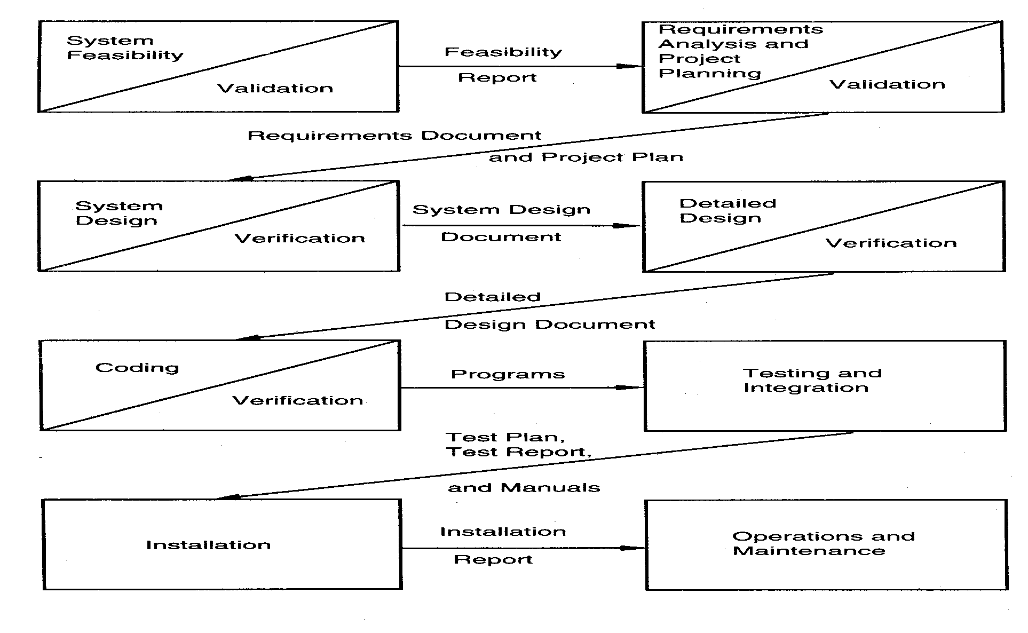
Classical Waterfall Model
Information System Design
Notes:
Lecture# 19
24/10/2007
IT60105: D. Samanta, SIT, IIT Kharagpur

Slide 18
Classical Waterfall Model
The classical waterfall model is elegant and intuitively the most obvious way to develop the system
The model is considered to be theoretical way of developing a system
Rather the model is not practical
Other life cycle models are essentially derived from the classical waterfall model
Information System Design
Notes:
Lecture# 19
24/10/2007
IT60105: D. Samanta, SIT, IIT Kharagpur

Slide 19
Classical Waterfall Model
The waterfall model is a classical development process model proposed by R. W. Royce in 1970.
In this model, software development proceeds through an orderly sequence of transitions from one phase to the next in order (like a waterfall).
It is the simplest and the most widely used model in development.
This model produces standard outputs at the end of every phase, which is called work products.
This model was enhanced with a feedback process, which is referred to as an iterative model.
Information System Design

Slide 20
Classical Waterfall Model
Feasibility study
Feasibility report
Requirements analysis
Requirement document
Software design
Design document
Coding
Programs
Testing and Integration
Test reports
Deployment
Release reports
Operation and Maintenance
Figure 2.4: Classical waterfall model
Information System Design

Slide 21
Classical Waterfall Model
Advantages
  The main advantage of the waterfall model is that it is easy to understand and implement.
  Due to the straightforward organization of phases, it is fit for other engineering process models, such as civil, mechanical, etc.
  It is a document-driven process model that can help new people to transfer knowledge.
  Milestones and deliverables at each stage can be used to monitor the progress of the project.
  This model works well on large and mature products. It is not well suited for small teams and projects.
  Where the requirements are well understood and the developers are confident, the waterfall model works well.
Information System Design

Slide 22
Classical Waterfall Model
Disadvantages
  The model assumes that the requirements will not change during the project. Sometimes, it is unrealistic to expect accurate requirements early in a project.
  It is very difficult to estimate the time and cost in the waterfall model.
  There may be difference of opinions among the specialists because there are specialized teams for each individual phase.
  The people mentally ready to work in a phase will have to wait until its previous phase is completed.
  Due to so much emphasis on documentation, sometimes people may become irritated.
  Fixing the software and hardware technology early may create problems for larger projects.
  There is no inherent risk management policy in this model.
  It is not well suited for small teams and projects.
Information System Design

Slide 23
Iterative Waterfall Model
The iterative waterfall model is an extended waterfall model with backtracking at each phase to its preceding phases.
The life cycle phases are organized similar to those in the classical waterfall model. The only difference is backtracking of phases on detection of errors at any stage.
The errors can come at any stage of the development life cycle.
Once a defect is detected there is a need to go back to the phase where it was introduced.
On defect detection at the source, some of the work performed during that phase and all the subsequent phases may be revised.
Information System Design

Slide 24
Iterative Waterfall Model
Feasibility study
Feasibility report
Requirements analysis
Requirement document
Software design
Design document
Coding
Programs
Testing and integration
Test reports
Deployment
Release reports
Operation and Maintenance
Backtracking
Figure 2.5: Iterative waterfall model
Information System Design

Slide 25
Iterative Waterfall Model
On error detection at any phase, it may be required that the preceding and succeeding phases be changed.
Detecting and removing defects earlier in the process of software development is called phase containment of errors.
Removing defects in early phases of development reduces testing and maintenance efforts.
The iterative waterfall model is the most widely used model and it is simple to apply it in projects.
Still it is a document-driven model.
Information System Design

Slide 26
Iterative Waterfall Model
It is very difficult to manage changes between the phases.
There is a possibility of blocking states, which can slow down the productivity and efficiency of the process.
Risks are not addressed in this model.
This model is most suitable for simple projects where the work products are well defined and their functioning is understood.
Information System Design

Slide 27
Iterative Waterfall Model
Advantages:
  Iterative waterfall model is practical compared to the classical waterfall model since errors are taken into consideration in it.
Drawbacks
  It is unable to handle different risks that a real-life software project is subjected to.
  It follows rigid phase sequence, but for higher productivity and better efficiency it may not be desirable at all.
  The model is suitable for well-understood problem, not suitable for very large projects.
Information System Design
Notes:
Lecture# 19
24/10/2007
IT60105: D. Samanta, SIT, IIT Kharagpur

Slide 28
Prototyping Model
Prototyping is an alternative in which partial working software (i.e. a prototype) is initially developed instead of developing the final product.
IEEE defines prototyping as “a type of development in which emphasis is placed on developing prototypes early in the development process to permit early feedback and analysis in support of the development process.”
Prototype development is a toy implementation, which provides a chance to the customer to give feedback for final product development.
A prototype provides limited functionalities, low reliability, and insufficient performance as compared to the actual software.
A prototype helps customer to understand the requirements that can further reduce the possibility of requirement changes.
Information System Design

Slide 29
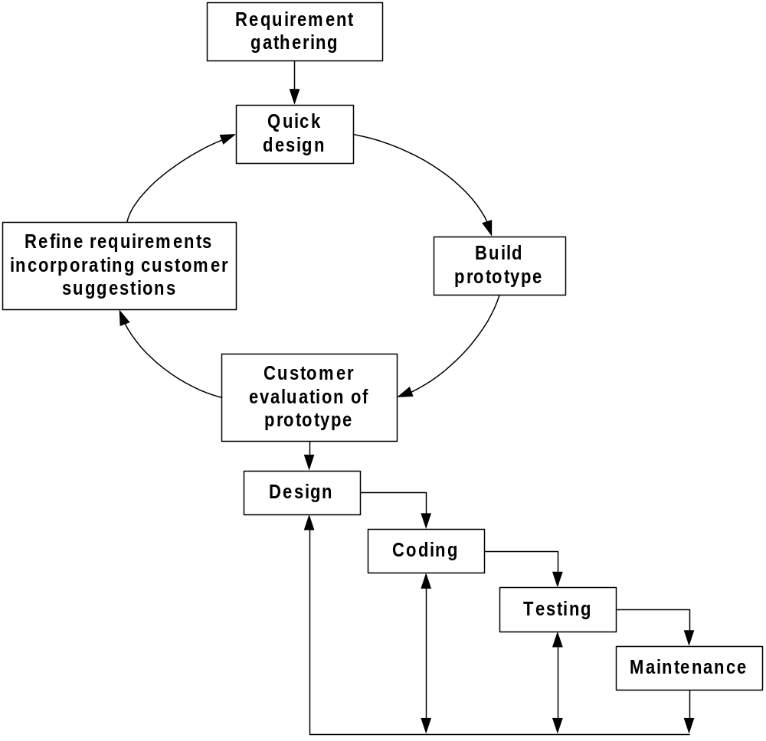
Prototyping Model
Information System Design
Notes:
Lecture# 19
24/10/2007
IT60105: D. Samanta, SIT, IIT Kharagpur

Slide 30
Prototyping Model
The prototype model is well suited for projects where requirements are difficult to understand and the customer is not confident in illustrating and clarifying the requirements.
It fits best where the customer risks are related to the changing requirements (software and hardware requirements) of the projects.
But this model requires exclusive involvement of the customer, which is not always possible.
Sometimes bad design decisions during prototype development may propagate to the real product.
Information System Design

Slide 31
Prototyping Model
It is expensive but deals with more complex and new system development (unlike waterfall model).
Many customer requirements get properly defined.
Technical issues get resolved by experimenting with the prototype.
Minimizes the redesign costs.
Information System Design
Notes:
Lecture# 19
24/10/2007
IT60105: D. Samanta, SIT, IIT Kharagpur

Slide 32
Evolutionary Model
This model is based on the incremental approach
User gets a chance to experiment with a partially developed system much before the complete version
Minimum redesign effort
Obviate the need to commit large resources in one go
Suitable for very large system development
Information System Design
Notes:
Lecture# 19
24/10/2007
IT60105: D. Samanta, SIT, IIT Kharagpur

Slide 33
Evolutionary Model
The Evolutionary Software Development Model is a software development approach in which the system is developed and delivered in small, incremental versions.
Requirements and solutions evolve through continuous feedback from users.
Instead of developing the entire software at once, developers create a basic version first and then improve it through multiple iterations until the final product is achieved.
Information System Design

Slide 34
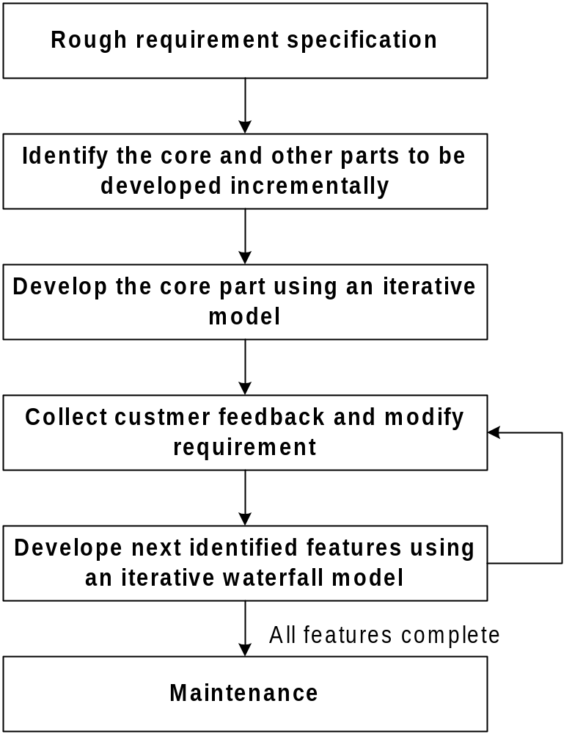
Evolutionary Model
Information System Design
Notes:
Lecture# 19
24/10/2007
IT60105: D. Samanta, SIT, IIT Kharagpur

Slide 35
Evolutionary Model
Advantages
Accommodates changing requirements.
Early delivery of a working system.
Continuous user involvement improves quality.
Reduces risk by identifying issues early.
Better customer satisfaction.
Information System Design

Slide 36
Evolutionary Model
Disadvantages
Difficult to estimate project cost and schedule.
Requires active user participation.
Documentation may be less inclusive.
Continuous changes can increase development time.
Information System Design

Slide 37
Evolutionary Model
Types of Evolutionary Development
Exploratory Development
  Starts with well-understood requirements and evolves by adding new features.
Throwaway Prototyping
  A prototype is built to clarify requirements and then discarded before developing the final system.
Information System Design

Slide 38
Evolutionary Model
Applications
Web applications
Mobile applications
Research and development projects
Systems with unclear or frequently changing requirements
Example:
A food delivery app is first released with basic ordering functionality. Based on user feedback, features such as live tracking, digital payments, ratings, and loyalty rewards are added in subsequent versions.
Information System Design

Slide 39
Incremental Model
The incremental model is an intuitive approach to the waterfall model with fewer restrictions.
The activities are performed in the same order as in the waterfall model, but they are conducted in several iterations.
Each iteration releases a fully functional work product by providing additional functionalities in successive releases.
The final iteration releases the complete product. The requirements are functionally divided and prioritized according to the needs of the customers.
A blueprint of the product based on the prioritized requirements is also designed, which describes dependency of tasks on each other.
Information System Design

Slide 40
Incremental Model
Iteration 1
Release 1
Design
Coding
Testing
Deployment
Iteration 2
Release 2
Requirement analysis
Design
Coding
Testing
Deployment
Operation and maintenance
…
…
Iteration N
Release N
Design
Coding
Testing
Deployment
Figure 2.7: Incremental Model
Information System Design

Slide 41
Incremental Model
A project control list is prepared, describing the order of the tasks to be performed and outcomes of the task to be released.
Each task in the project control list is treated as a mini project.
Each item in the list is a module, which is to be developed in increments.
Each task is removed from the project control list and developed using the waterfall model in a sequential manner.
Each new release is integrated with the existing increments to provide enhanced functionality with each delivered increment.
The length of iterations is generally kept very short and fine. For example, an iteration can be a duration of 6 weeks, 10 weeks, etc.
The number of iterations depends upon the nature of the project and the features it supports.
Information System Design

Slide 42
Incremental Model
The main advantage of the incremental model is the early production of working software during the software life cycle.
Because each module is tested thoroughly, there is little possibility to change scope and requirements in the final software.
Due to incremental development, testing and debugging of each module becomes easier.
This model is also helpful in handling risks (technical, requirements, usability, etc.) because risky modules are identified and handled in a separate iteration.
This model is suitable for larger projects where requirements are somewhat clear and which need phase-wise implementation.
Information System Design

Slide 43
Incremental Model
Mostly this model is used in web applications, object-oriented development projects, and product-based companies.
Also, it is widely used by many commercial software companies and system vendors.
Each phase of an iteration is rigid and does not overlap another. Therefore, coordination between iterations is required for better quality products.
Sometimes, an initial upfront cost is required for parallel development of various modules.
Information System Design

Slide 44
Incremental Model
Disadvantages
Requires careful planning and system architecture.
Integration of increments can be complex.
Not suitable if the system cannot be divided into independent modules.
Total project cost may increase due to repeated integration and testing.
Information System Design

Slide 45
Spiral Model
The spiral model is an iterative software development approach, which was proposed by Boehm in 1988.
In this model, activities are organized as a spiral with many loops.
Each loop in the spiral represents a phase of software development.
The exact number of loops in the spiral is not fixed.
The main focus of this model is identification and resolution of potential risks (product risks, project risks, and process risks).
Information System Design

Slide 46
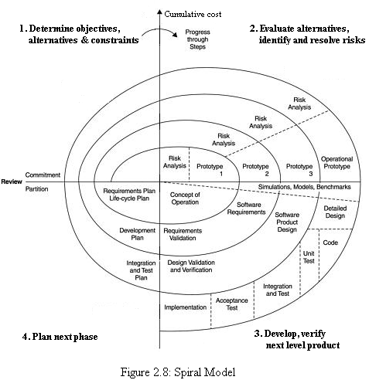
Spiral Model
Information System Design

Slide 47
Spiral Model
Each loop in the spiral is split into four quadrants. Each of these four quadrants is used for the development of each phase.
  Determine objectives, alternatives, and constraints.
  Evaluate alternatives; identify and resolve risks.
  Develop, verify the next level product.
  Plan for the next phase.
Information System Design

Slide 48
Spiral Model
The radial dimension represents the cumulative cost incurred so far for the development of phases in a project.
The angular dimension indicates the progress made so far in completing each cycle.
It is considered a meta model because it incorporates the features of all other models, which are the waterfall, prototyping, incremental, simulation, and performance models.
Information System Design

Slide 49
Spiral Model
The iterative and risk-driven approach of the spiral model is widely used in software development.
This model is most suitable for projects having high risks and also for large, complex, and ambitious projects.
The estimates (i.e. budget, schedule, etc.) get more realistic as work progresses because important issues are discovered earlier.
Information System Design

Slide 50
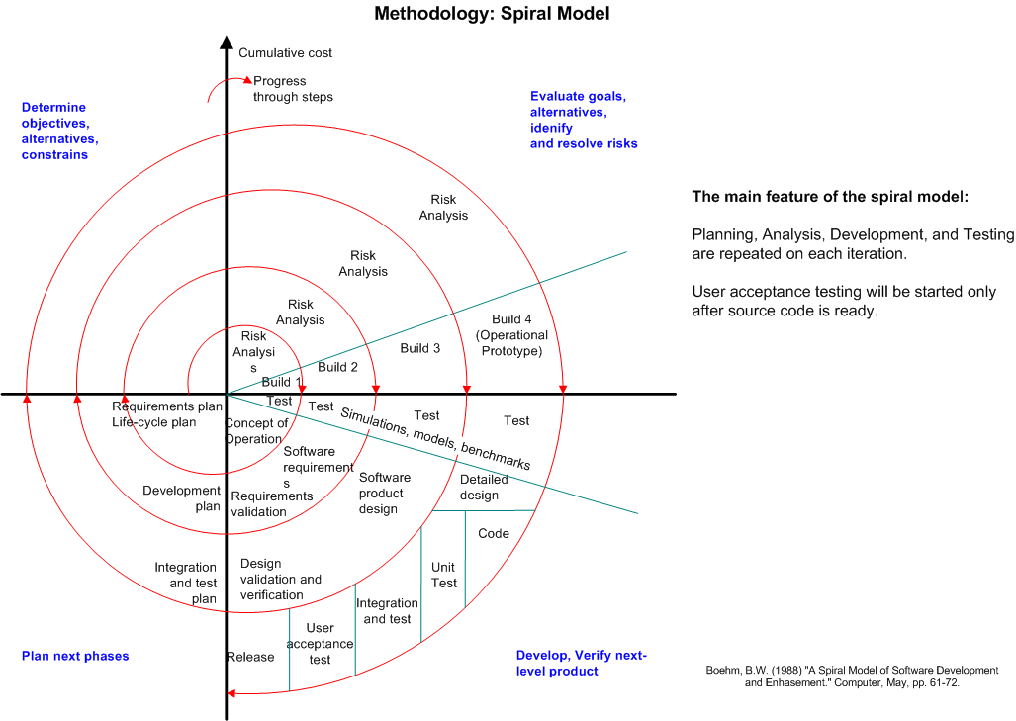
Spiral Model
Information System Design
Notes:
Lecture# 19
24/10/2007
IT60105: D. Samanta, SIT, IIT Kharagpur

Slide 51
Spiral Model
Spiral model is also termed as meta model, since it subsumes all the previously discussed models
Unlike other models, it provides good insight to the project risks
Spiral model is much more flexible compared to other models
This model looks like a spiral with many loops
The number of loops is not fixed rather decided by
  Number of phases
  Iteration of the phases
Exact number of phases and order of phases is not fixed hence the model is more flexible
There are four stages of each phase, which is depicted by four sectors in the model
As a loop proceeds, a more complete version of the system gets build
  Radius of spiral at any point represents the cost incurred in the project till then
  Angular dimension represents the progress made in the current phase
Information System Design
Notes:
Lecture# 19
24/10/2007
IT60105: D. Samanta, SIT, IIT Kharagpur

Slide 52
Time-boxing
It has linear sequence of iterations. Each iteration is a mini waterfall – decide the specifications, then plan the iteration
Time boxing – fix an iteration duration, then determine the specifications
Divide iteration in a few equal stages
Use pipelining concepts to execute iterations in parallel
In time boxed iterations – fix the duration of iteration and adjust the functionality to fit it
Completion time is fixed, the functionality to be delivered is flexible
Development is done iteratively in fixed duration time boxes
Each time box divided in fixed stages
Each stage performs a clearly defined task that can be done independently
There is a dedicated team for each stage
When one stage team finishes, it hands over the project to the next team
Information System Design
Notes:
Lecture# 19
24/10/2007
IT60105: D. Samanta, SIT, IIT Kharagpur

Slide 53
Time-boxing: Example
An iteration with three stages – Analysis, Build, Deploy
  These stages are appx equal in many situations
  Can adjust durations by determining the boudaries suitably
  Can adjust duration by adjusting the team size for each stage
Have separate teams for A, B, and D
Pipelined Execution
  AT starts executing it-1
  AT finishes, hands over it-1 to BT, starts executing it-2
  AT finishes it-2, hands over to BT; BT finishes it-1, hands over to DT; AT starts it-3, BT starts it-2 (and DT, it-1)
Information System Design
Notes:
Lecture# 19
24/10/2007
IT60105: D. Samanta, SIT, IIT Kharagpur

Slide 54
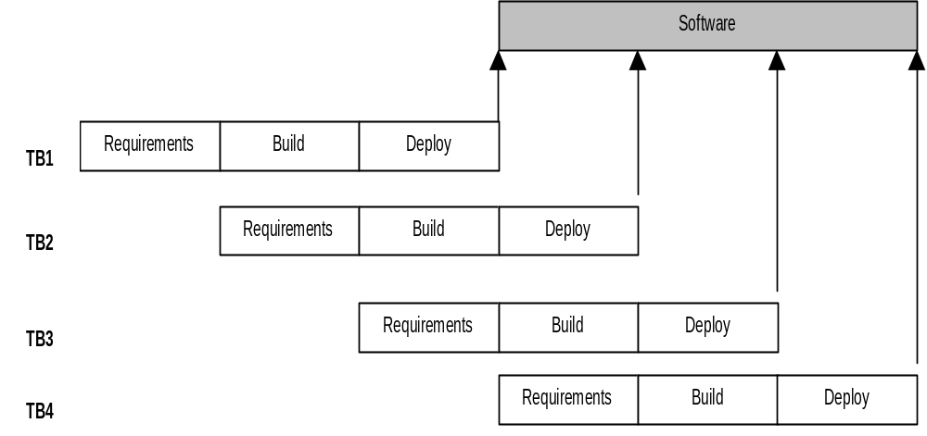
Time-boxing execution
Information System Design
Notes:
Lecture# 19
24/10/2007
IT60105: D. Samanta, SIT, IIT Kharagpur

Slide 55
Time-boxing execution
First iteration finishes at time T
Second finishes at T+T/3; third at T+2 T/3, and so on
In steady state, delivery every T/3 time
If T is 3 weeks, first delivery after 3 wks, 2nd after 4 wks, 3rd after 5 wks,…
In linear execution, delivery times will be 3 wks, 6 wks, 9 wks,…
Duration of each iteration still the same
Total work done in a time box is also the same
Productivity of a time box is same
Yet, average cycle time or delivery time has reduced to a third
Information System Design
Notes:
Lecture# 19
24/10/2007
IT60105: D. Samanta, SIT, IIT Kharagpur

Slide 56
Time-boxing: Team Size
In linear execution of iterations, the same team performs all stages
If each stage has a team of S, in linear execution the team size is S
In pipelined execution, the team size is three times (one for each stage)
I.e. the total team size in time-boxing is larger; and this reduces cycle time
Merely by increasing the team size we cannot reduce cycle time - Brook’s law
Time-boxing allows structured way to add manpower to reduce cycle time
Note that we cannot change the time of an iteration – Brook’s law still holds
Work allocation different to allow larger team to function properly
Information System Design
Notes:
Lecture# 19
24/10/2007
IT60105: D. Samanta, SIT, IIT Kharagpur

Slide 57
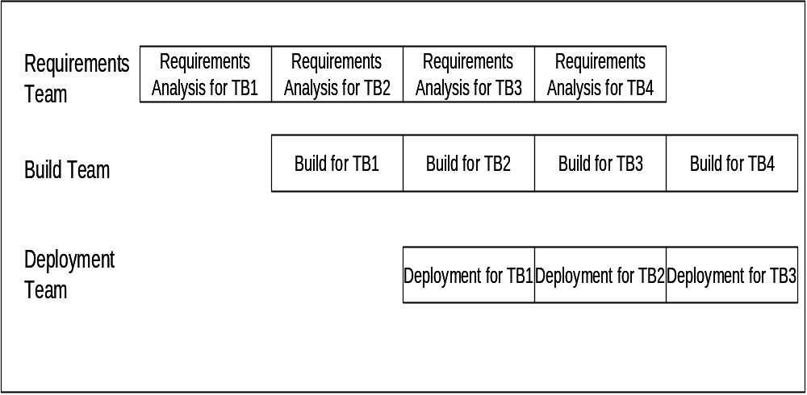
Time-boxing: Work Allocation of Teams
Information System Design
Notes:
Lecture# 19
24/10/2007
IT60105: D. Samanta, SIT, IIT Kharagpur

Slide 58
Time-boxing
Advantages:
  Shortened delivery times, other advantage is iterative, distributed execution.
Disadvantages:
  Larger teams, project management is harder, high synchronization needed, Configuration management is harder.
Applicability:
  When short delivery times is very important, architecture is stable; flexibility in feature grouping.
Information System Design
Notes:
Lecture# 19
24/10/2007
IT60105: D. Samanta, SIT, IIT Kharagpur

Slide 59
RAD Model
Rapid application development (RAD) model is a process model, which involves incremental process model and prototyping model.
This model emphasizes on short development cycle and modularization of software system into components, each of which can be constructed by different teams.
It is a high-speed version of the waterfall model, in which rapid development is achieved by using component-based development approach.
This model helps to create a fully-functional system in short duration (i.e., 60 to90 days), if the requirements are well understood and project scope is constrained.
Information System Design

Slide 60
RAD Model
Requirements
Project planning
Team #1
Team #2
Team #n
Modeling
Business modeling
Data modeling
Process modeling
Modeling
Business modeling
Data modeling
Process modeling
Modeling
Business modeling
Data modeling
Process modeling
Construction
Construction
Construction
Unit testing
Unit testing
Unit testing
Integration and testing
Deployment
Figure 2.10 RAD model
Information System Design

Slide 61
RAD Model
RAD model starts with the business requirements, where business problem and project scope are defined.
Software project is partitioned into independent systems or software components and these are developed by different teams in parallel.
Modeling is carried out using prototyping approach to refine the data and process models, and finalize the system’s analysis and design.
  Business modeling consists of the flow of information among business functions in the project.
  Data modeling is refined into the set of objects, identifying their attributes and relationships among objects.
  Process modeling is done to describe the implementation of the business model.
Information System Design

Slide 62
RAD Model
In construction phase,
  reusable components are used for construction.
  Automatic application-generation tools are also used for construction.
  The code for some components is written from the scratch, if the reusable components are neither available nor generated through automatic tools.
Unit testing is performed to ensure that the modules are working properly.
In integration and testing, components are assembled together and then integration testing is performed as a whole.
Software is deployed at the customer site, manual is prepared, and training is provided to end users for demonstrating the system operations.
Information System Design

Slide 63
RAD Model
RAD reduces the development time by using CBD approach.
Business functions are modularized and, therefore, it is easier to produce them.
Implementation of RAD is suitable for well-understood, simple, and GUI-based applications.
Since this model is based on time constraints, commitment is required from, both, end user and developer.
Customer and end user’s involvement is required for regular feedback and finalizing requirements.
RAD model is extended to promote agile methods, where products are produced in short time duration with strict timelines.
Information System Design

Slide 64
Rapid Application Development
It is an objective-oriented approach to system development
RAD and Prototyping are conceptually very close
Goal of RAD is to shorten the time typically needed in a traditional SDLC
There are three phases in RAD
  Requirement planning
  Design
  Implementation
Information System Design
Notes:
Lecture# 19
24/10/2007
IT60105: D. Samanta, SIT, IIT Kharagpur

Slide 65
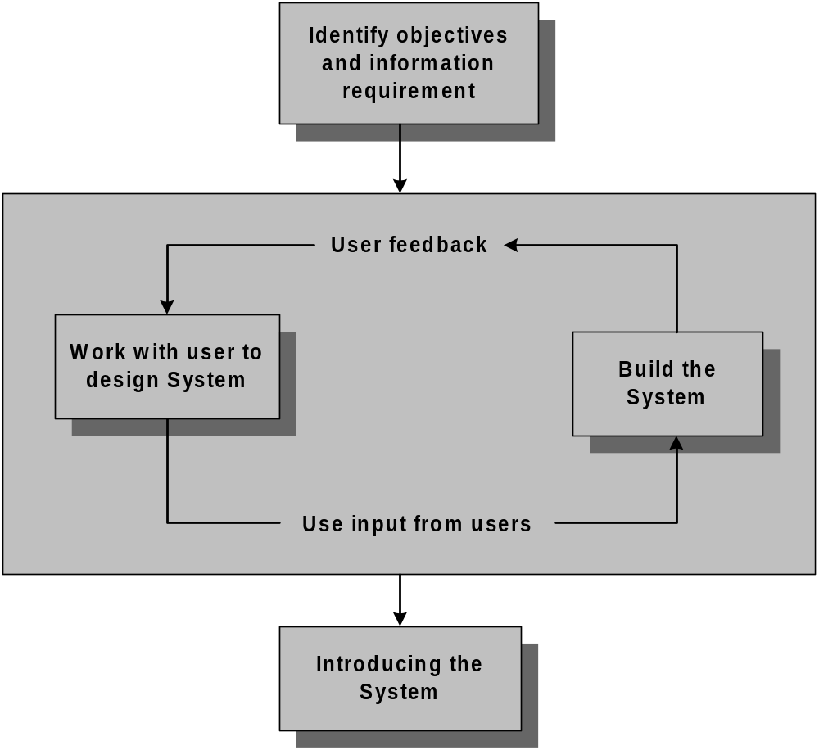
Rapid Application Development
Information System Design
Notes:
Lecture# 19
24/10/2007
IT60105: D. Samanta, SIT, IIT Kharagpur

Slide 66
Rapid Application Development
Advantages
  Useful for inexperienced team
  Pressing business for speeding up the system development
  Working with novel system development
  Developing system for sophisticated users
  RAD can be merged with SDLC
Disadvantages
  Not a systematic approach
  Hardly bother about system documentation
  Time vs. Attention trade-off
Information System Design
Notes:
Lecture# 19
24/10/2007
IT60105: D. Samanta, SIT, IIT Kharagpur

Slide 67
Component-Based Software Engineering
In majority of the software project there is some software reuse
  Components which are readily available to a team can be modified them as needed and incorporated them into their system
  Reuse is often essential for rapid system development
CBSE is a reuse-oriented approach
  It follows a large base of reusable software components and some integrating framework for these components
  These components are called COTS (Commercial Off-The-Shelf)
Information System Design
Notes:
Lecture# 19
24/10/2007
IT60105: D. Samanta, SIT, IIT Kharagpur

Slide 68
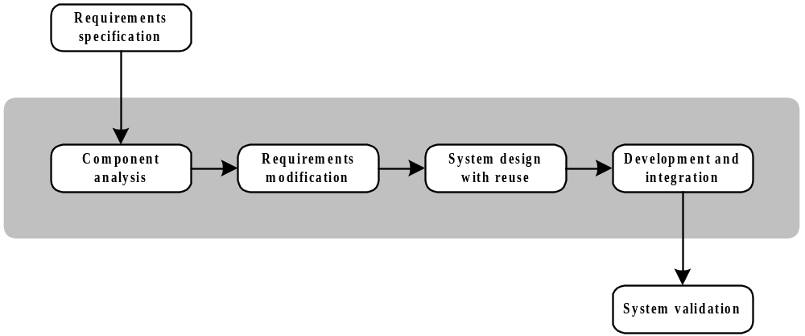
Generic Process Model of CBSE
Information System Design
Notes:
Lecture# 19
24/10/2007
IT60105: D. Samanta, SIT, IIT Kharagpur

Slide 69
Component-Based Software Engineering
Advantages
  Reduces the amount of software to be developed
  Reduces the cost of development
  Reduces risk
Disadvantages
  Requirement compromises are inevitable
  May lead to a system that does not meet the real needs of users
  Control over the system evolution is lost as the new versions of the reusable components are not under the control of the project group
Information System Design
Notes:
Lecture# 19
24/10/2007
IT60105: D. Samanta, SIT, IIT Kharagpur

Slide 70
Agile Software Development
Weakness of traditional development:
  Hardly bother about system documentation
  Time vs. Attention trade-off
  Miscommunication
  Redesign is problematic
  Back traversing is not allowed
  Can cause systems to be left unfinished and/or implemented before they are ready.
Agile software development is a group of software development methods based on iterative and incremental development.
It uses where requirements and solutions evolve through collaboration between self-organizing, cross-functional teams.
It promotes adaptive planning, evolutionary development and delivery, a time-boxed iterative approach, and encourages rapid and flexible response to change.
Information System Design

Slide 71
Agile Software Development
It is driven by customer descriptions of what is required (scenarios)
Recognizes that plans are short-lived
Develops software iteratively with a heavy emphasis on construction activities
Delivers multiple ‘software increments’
Adapts as changes occur
Effective (rapid and adaptive) response to change
Effective communication among all stakeholders
Drawing the customer onto the team
Organizing a team so that it is in control of the work performed
Information System Design

Slide 72
Agile Methodology
Agile is a set of software development methods that aim to be more effective.
Agile methodologies are iterative & incremental which means its known for breaking a project into smaller parts & adjust to changing requirements.
Agile methodologies prioritize flexibility, collaboration & customer satisfaction.
Major companies like Facebook, Google & Amazon use Agile because of its adaptability & customer focussed approach.
It is an iterative & incremental approach to S/W development that emphasizes on delivering a work product quickly & frequently.
Information System Design

Slide 73
Agile Methodology
Agile methodology is an iterative and incremental approach to software development in which software is developed in small, manageable parts, with continuous customer feedback and frequent releases.
Agile focuses on flexibility, collaboration, customer satisfaction, and rapid delivery of working software.
Information System Design

Slide 74
Agile Methodology
Principles of Agile Methodology
Customer satisfaction – Deliver useful software early and continuously.
Respond to change – Requirements can be changed even during development.
Frequent delivery – Working software is released in short iterations.
Customer collaboration – Developers and customers work closely together.
Team collaboration – Developers, testers, customers, and other stakeholders communicate regularly.
Working software – Working software is more important than excessive documentation.
Continuous improvement – Teams regularly review their work and improve their process.
Sustainable development – Maintain a steady and manageable development pace.
Information System Design

Slide 75
Agile Methodology
Agile development cycle
Requirements → Planning → Design → Development → Testing → Review → Release → Feedback → Next Iteration
Each iteration produces a working increment of the software.
Information System Design

Slide 76
Agile Methodology
Advantages
It handles changing requirements easily.
It provides frequent delivery of working software.
It detects errors early through continuous testing.
It encourages customer involvement.
It improves communication and teamwork.
It reduces the risk of developing an unsuitable product.
Information System Design

Slide 77
Agile Methodology
Limitations
It requires active customer participation.
It gives less emphasis on detailed documentation which can create problems in some projects.
It is difficult to apply when requirements and scope must remain fixed.
It requires experienced and highly collaborative teams.
Information System Design

Slide 78
Types of Agile frameworks
Kanban
Scrum
XP or Extreme Programming
Crystal
FDD or Feature Driven Development
Information System Design

Slide 79
Extreme Programming or XP
Extreme Programming (XP) is an Agile software development methodology that focuses on high-quality software, rapid development, continuous testing, frequent customer feedback, and adaptability to changing requirements.
XP is particularly suitable for projects where requirements are expected to change frequently.
Extreme Programming is an Agile methodology that emphasizes on frequent releases, continuous testing, pair programming, customer feedback, simple design, and rapid response to changing requirements.
Information System Design

Slide 80
Extreme Programming or XP
Main Practices of Extreme Programming
Pair Programming
Two programmers work together on the same task. One writes the code while the other reviews it.
Test-Driven Development (TDD)
Tests are written before the actual program code. Code is then developed to pass the tests.
Continuous Integration
Developers integrate their code frequently and run tests to identify problems early.
Small Releases
Working software is released frequently in small increments.
Information System Design

Slide 81
Extreme Programming or XP
Refactoring
Existing code is continuously improved to make it simpler, cleaner, and easier to maintain without changing its functionality.
Simple Design
Developers create the simplest design that satisfies the current requirements.
Collective Code Ownership
Any team member can modify and improve any part of the source code.
Customer Involvement
The customer works closely with the development team and provides continuous feedback.
Information System Design

Slide 82
Extreme Programming or XP
Coding Standards
Team members follow common coding conventions to maintain consistency.
Sustainable Pace
Developers avoid excessive overtime and maintain a productive, sustainable working pace.
XP Development Cycle
User Stories → Planning → Design → Coding → Testing → Integration → Small Release → Customer Feedback → Next Iteration
Information System Design

Slide 83
Extreme Programming or XP
Advantages of XP :-
It handles changing requirements effectively.
It provides frequent working software.
It detects defects early.
It improves software quality.
It encourages customer participation.
It promotes teamwork and communication.
It reduces technical problems through continuous testing and refactoring.
Information System Design

Slide 84
Extreme Programming or XP
Limitations of XP :-
It requires continuous customer involvement.
The use of pair programming may increase initial development effort.
It requires experienced and disciplined developers.
It can be difficult for very large or geographically distributed teams.
It has limited documentation which may create maintenance challenges in some cases.
Information System Design

Slide 85
Extreme Programming or XP
Example
Suppose a team is developing an online shopping system. Instead of developing the complete system at once, the XP team may develop:
Iteration 1: User registration and login
Iteration 2: Product search
Iteration 3: Shopping cart
Iteration 4: Online payment
Iteration 5: Order tracking
After each iteration, the customer provides feedback, and the team incorporates the required changes.
Information System Design

Slide 86
Scrum
Scrum is an agile team framework commonly used for S/W development.
Scrum is an Agile framework used for developing, delivering, and maintaining software through short, iterative development cycles called Sprints.
It emphasizes teamwork, continuous feedback, transparency, and the delivery of a working product increment.
Scrum prescribes for teams to break work into goals to be completed within time boxed iterations called Sprints.
Each Sprint is not longer than 1 month & commonly lasts 2 weeks.
The Scrum team evaluates progress in time-boxed, stand up meetings of upto 15 min. called Daily Scrums.
At the end of the sprint, the team holds 2 further meetings –one sprint review to demonstrate the work for stakeholders & take feedback and other to evaluate sprint retrospective.
Information System Design

Slide 87
Scrum
Key Characteristics of Scrum :-
Work is divided into small increments.
The development takes place in fixed periods called Sprints, usually 1–4 weeks.
The requirements are maintained in a Product Backlog.
The team selects work for each Sprint in Sprint Planning.
The project progress is discussed in a short Daily Scrum.
At the end of the Sprint, the product increment is reviewed.
The team conducts a Sprint Retrospective to improve its process.
Information System Design

Slide 88
Scrum
Scrum Roles
Product Owner
Represents the customer and stakeholders.
Defines and prioritizes requirements.
Manages the Product Backlog.
Maximizes the value of the product.
Scrum Master
Facilitates the Scrum process.
Removes obstacles faced by the team.
Helps the team follow Scrum principles.
Supports continuous improvement.
Information System Design

Slide 89
Scrum
Developers
Design, develop, test, and deliver the product increment.
Organize their technical work collaboratively.
Scrum Artifacts
1. Product Backlog
A prioritized list of all desired features, improvements, and fixes.
2. Sprint Backlog
The Product Backlog items selected for the current Sprint, along with the plan for delivering them.
3. Increment
The usable, completed product functionality produced during a Sprint.
Information System Design

Slide 90
Scrum
Scrum Events
1. Sprint Planning
The team decides what work will be done during the Sprint.
2. Daily Scrum
A short daily meeting where Developers inspect progress and plan the next day's work.
3. Sprint Review
The completed Increment is presented and feedback is collected.
4. Sprint Retrospective
The team discusses what went well, what went wrong, and how to improve.
Information System Design

Slide 91
Scrum
Advantages of Scrum
It allows faster delivery of working software
It allows easy adaptation to changing requirements
It takes continuous customer feedback
It has better team collaboration
In Scrum the problems are identified early
It has continuous improvement to improve
Information System Design

Slide 92
Scrum
A person incharge of the scrum team is called scrum master.
A scrum team consists of the product owner, developers & the scrum master.
Each scrum team has 1 product owner. The product owner focusses on the business side of the product development & spends majority of time in communicating with the stakeholders & the team.
The product owner manages the product backlog & is responsible for maximizing the value that a team delivers.
In scrum the team developer or team member refers to anyone who plays a role in the development & support of the product.
Scrum is facilitated by a scrum master, whose role is to educate & coach teams about scrum theory & practice.
Information System Design

Slide 93
Elements of Scrum
Sprint – A sprint also known as iteration or time box is a fixed period of time wherein team members work on a specific goal. Each sprint is normally between 1 week & 1 month with 2 weeks being the most common.
The outcome of each sprint is a functional, deliverable product or increment.
Each sprint starts with a sprint planning event in which a goal is defined.
Each sprint ends with 2 events –
A Sprint review – Progress shown to stakeholders to elicit their feedback.
A sprint retrospective – Identifying lessons & improvements for the next sprints.
Information System Design

Slide 94
Elements of Scrum
Daily scrum – Each day during a sprint, the developers hold a daily scrum with specific guidelines & which may be facilitated by a scrum master.
Daily scrum meetings are intended to be less than 15 min. in length, taking place at the same time & location daily.
Product backlog – The product backlog is a breakdown of work to be done & it contains an ordered list of product requirements that team maintains for a product.
Backlog items include user stories.
Information System Design

Slide 95
Elements of Scrum
Sprint Backlog- The sprint backlog is the subset of items from the product backlog intended for developers to address in a particular sprint.
The developers fill this backlog with tasks they feel appropriate for a sprint.
Information System Design

Slide 96
Scrum
It is a completely developed and tested feature in short iterations.
It is a simple process with clearly-defined rules.
It increases productivity and the self-organizing team member carries a lot of responsibility.
Also, it improves communication and combination with extreme programming.
However, it has no written documentation and sometimes violation of responsibilities may occur.
Information System Design

Slide 97
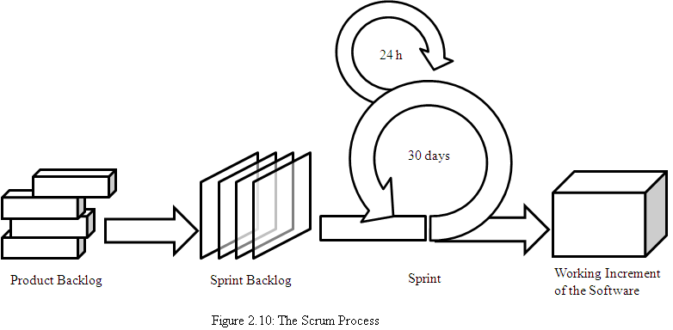
Scrum process
Information System Design

Slide 98
Other agile methods
Agile Modeling (AM)
Agile Project Management (APM)
Scaled Agile Framework (Safe)
Agile Unified Process (AUP)
Disciplined Agile Delivery (DAD)
Scrumban
Openup
Information Radiator
Servant Leader
Lean Startup
Agile Metrics etc.
Information System Design

Slide 99
Agile manifesto
“We are uncovering better ways of developing software by doing it and helping others do it. Through this work we have come to value:
  Individuals and interactions over processes and tools
  Working software over comprehensive documentation
  Customer collaboration over contract negotiation
  Responding to change over following a plan
That is, while there is value in the items on the right, we value the items on the left more.”
Information System Design

Slide 100
Agile process models
Extreme Programming (XP)
Adaptive Software Development (ASD)
Feature-Driven Development (FDD)
Model-Driven Development (MDD)
Crystal Methods
Information System Design

Slide 101

Extreme Programming (XP) practices
Information System Design

Slide 102
RUP Process Model
  The Rational Unified Process (RUP) is a use-case-driven, architecture-centric, incremental and iterative software development methodology in which software is developed through repeated cycles, with each cycle producing an improved version of the system.
The Rational Unified Process (RUP) is characterized by four key principles:
Use-case driven – System requirements are captured and organized using use cases, which guide development, testing, and documentation.
Architecture-centric – A robust system architecture is established early and continuously refined to manage complexity and risk.
Information System Design

Slide 103
RUP Process Model
Iterative – Development proceeds in repeated cycles (iterations), allowing feedback and refinement at each step.
Incremental – Each iteration delivers an increment of working functionality, building the system progressively
  It is a process product, developed and maintained by Rational® Software.
  The RUP focuses on creating and maintaining models rather than documentation.
  It is derived from Unified Modeling Language (UML), which is an industry-standard language that helps to clearly communicate requirements, architectures, and designs.
  The RUP is supported by tools which automate most of the activities of the process.
Information System Design

Slide 104
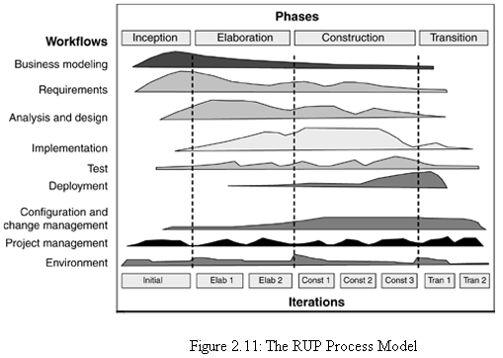
RUP Process Model
Information System Design

Slide 105
RUP Process Model
Inception phase
  It establishes the business case for the system and delimit the project scope.
  This phase produces vision document of the project, initial use-case model, initial risk assessment, business model, and a project plan showing the phases and iterations.
  At this stage, customers will be clear with their requirements and life cycle objectives milestone will be produced.
Elaboration phase- It analyzes the problem domain, establishes an architectural framework, develops the project plan, and eliminates the highest risk elements of the project.
Information System Design

Slide 106
RUP Process Model
Construction phase:
  All application features are developed, integrated, and thoroughly tested.
  This phase also focuses on the user manuals and the current beta release details.
Transition phase:
  The purpose of the transition phase is to move the software product to the user community for working.
  This phase includes several iterations, including beta releases, general availability releases, as well as bug-fix and enhancement releases.
Information System Design

Slide 107
RUP process model
The Rational Unified Process (RUP) is a use-case driven, architecture-centric, iterative and incremental process model.
The RUP focuses on creating and maintaining models rather than documentation. It is derived from Unified Modeling Language (UML)
The RUP divides the development cycle into four consecutive phases, namely; inception, elaboration, construction and transition.
Information System Design

Slide 108
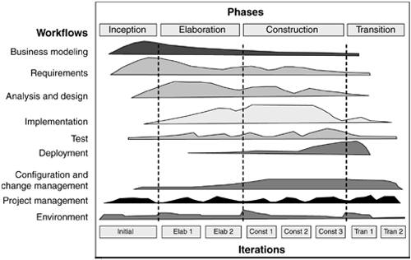
RUP process model
Information System Design

Slide 109
RUP process model
Inception phase establishes the business case for the system and delimit the project scope.
Elaboration phase analyzes the problem domain, establish an architectural framework, develop the project plan, and eliminate the highest risk elements of the project.
Construction phase focuses on development, integration and testing.
Transition phase moves the software product to the user community for working.
Information System Design

Slide 110
Exercises
Discuss the applications of each development model? List at least five examples of each?
Arrange the life cycle models in order according to development time, redesign time (customer satisfaction), problem size and the cost.
Classify the development models between iterative and non-iterative development.
Suppose that the stages in a time box in the time-boxing model are unequal. What will be the impact on delivery time and resource utilization?
Identify five component repository, which are used in different application areas of development.
Why RAD is suitable for object-oriented system development?
Compare traditional and agile process models. What are the differences and similarities among them.
Information System Design
Notes:
Lecture# 19
24/10/2007
IT60105: D. Samanta, SIT, IIT Kharagpur

